Slide 1
Unified Robotics II Term Project
Kurtis RickelmanN

Slide 2
Project Objective Description
Design and build a fully automated robotic system that performs a pick-and-place operation.
Identify metal squares and triangles on a white surface 12 inches away
Pick the parts with the robot arm
Sort the parts into two distinct piles on either side of the robot

Slide 3
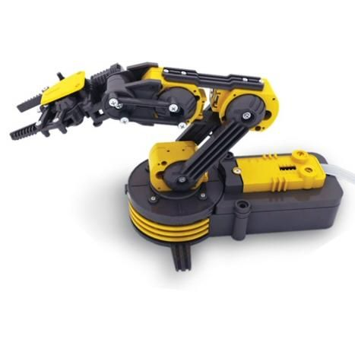
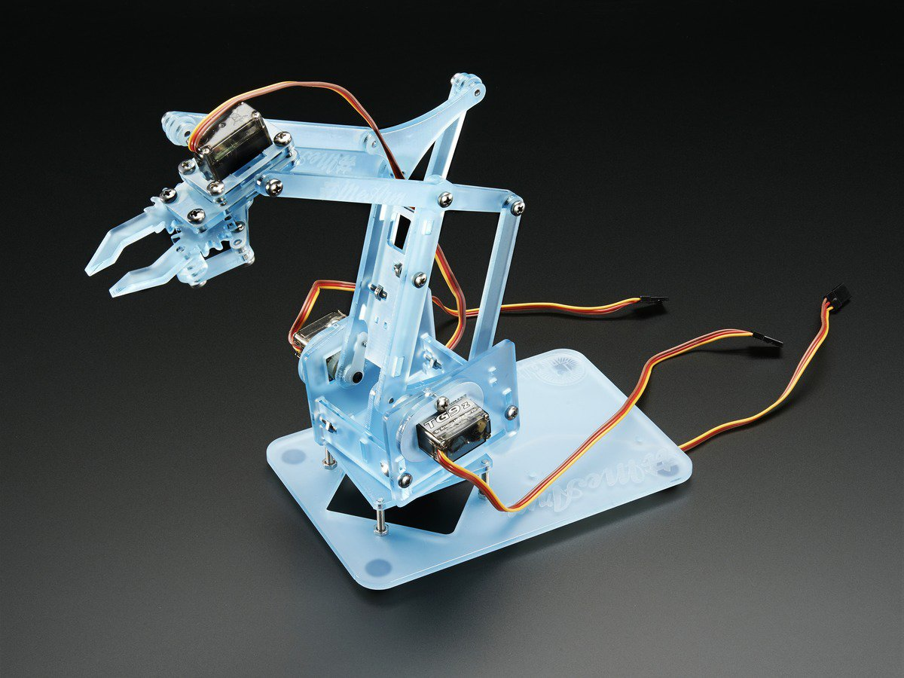
Market Research
OWI Robotic Arm (~$50)
MeArm Robot Arm (~$40 w/out controller)

Slide 4
Market Research
The robots in the previous slide are very popular
Price
Functionality
Ease of Use
My goals after researching
Simple Design and Simple Mechanical “Skeleton”
Easy to change the program when necessary
Use of quality parts at a good price (preferably under $100 in total)

Slide 5
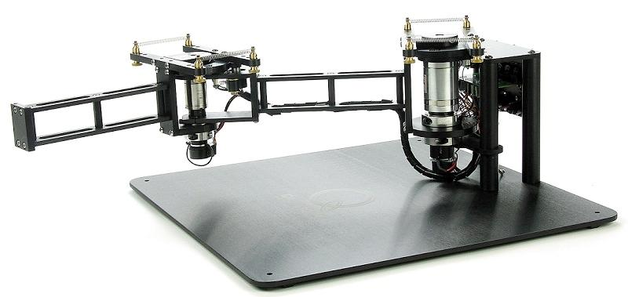
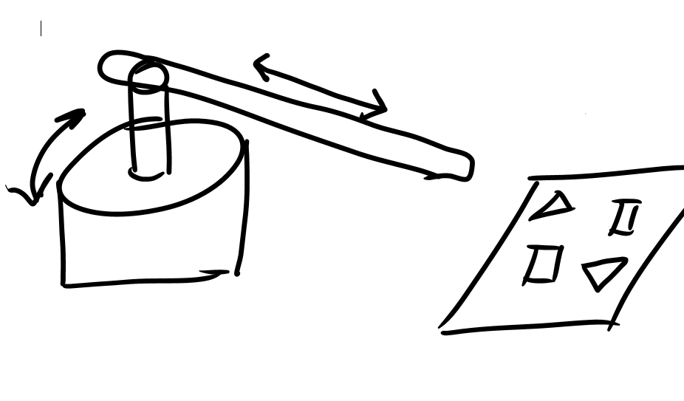
Designs Considered (Different from my design)
2 DOF robot similar to Torsten’s
2 DOF robot with one servo and a linear actuator

Slide 6
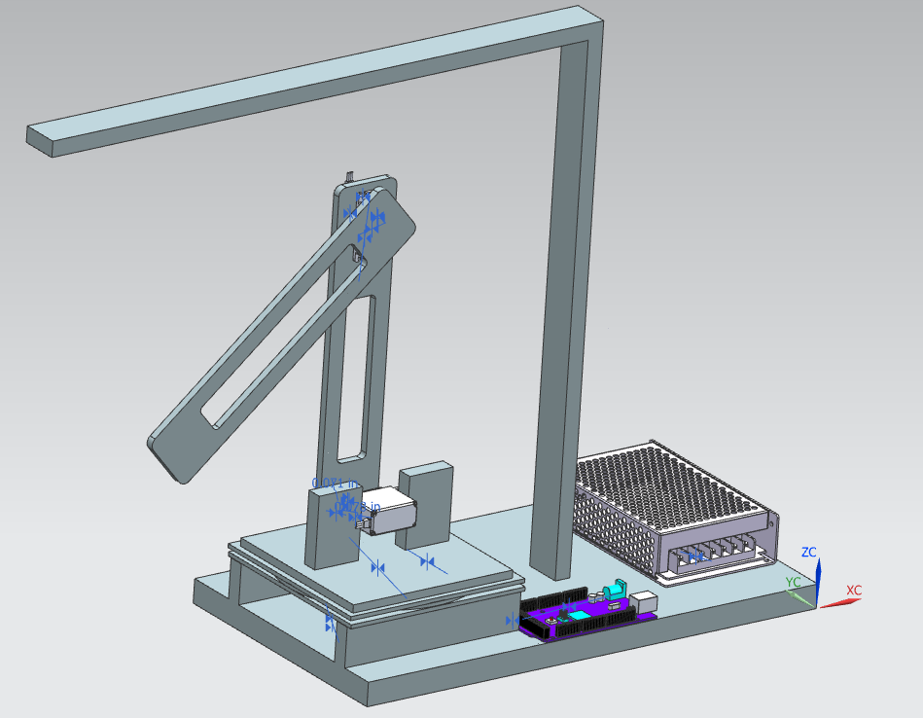
Final Proposed Design (Design Overview)
CAD Model shown to the right
Components:
3 Servo Motors
Arduino Mega
12V Electromagnet
5V Power Supply
12v Battery
Logitech Camera

Slide 7
Final Proposed Design (Why I Chose This Design)
I liked the mechanical design of the OWI robot kit
The design is simple yet it is sufficient enough to get the job done
It was pretty easy to construct/assemble.
All the parts are readily available (for the most part)

Slide 8
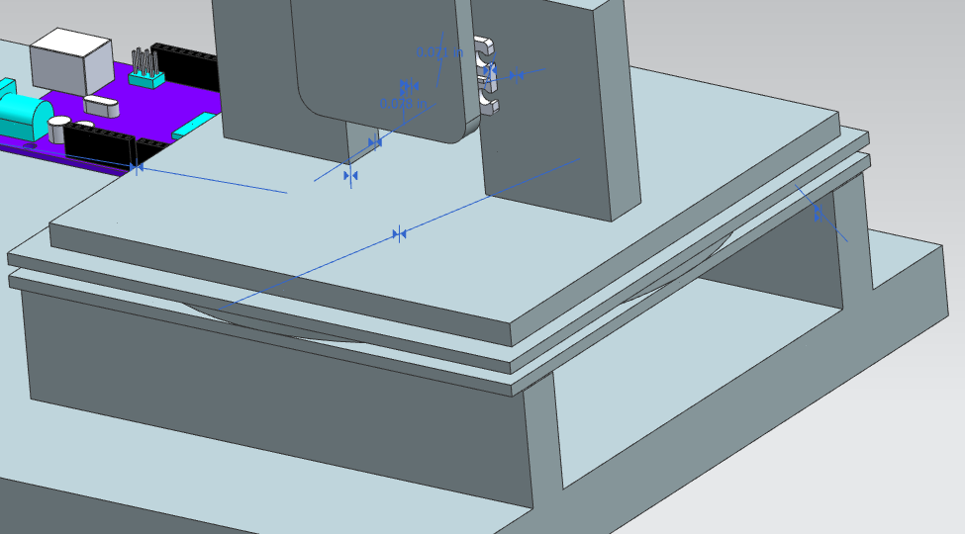
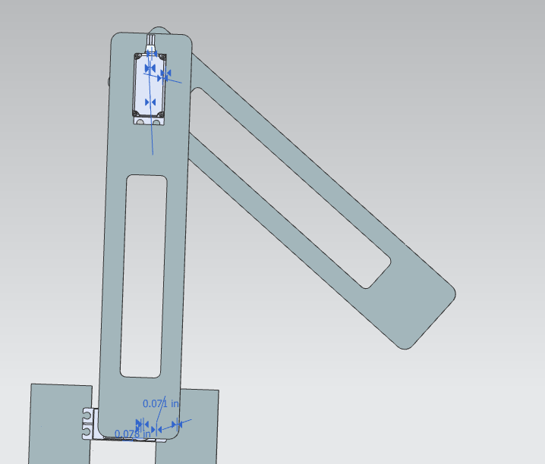
Final Proposed Design (Mechanical Design)
Rotating base with a lazy Susan turntable to reduce the torque needed to turn the base.
Powered by a Radient Servo
Two Arms of same length made of Fiberglass
Lightweight
Also powered by Radient Servos

Slide 9
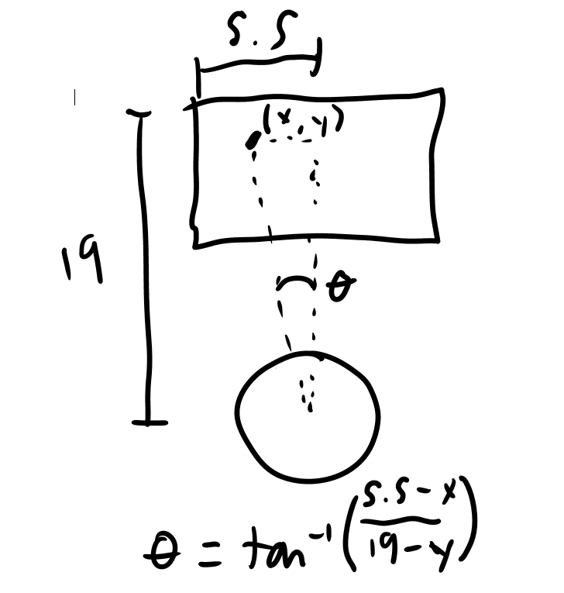
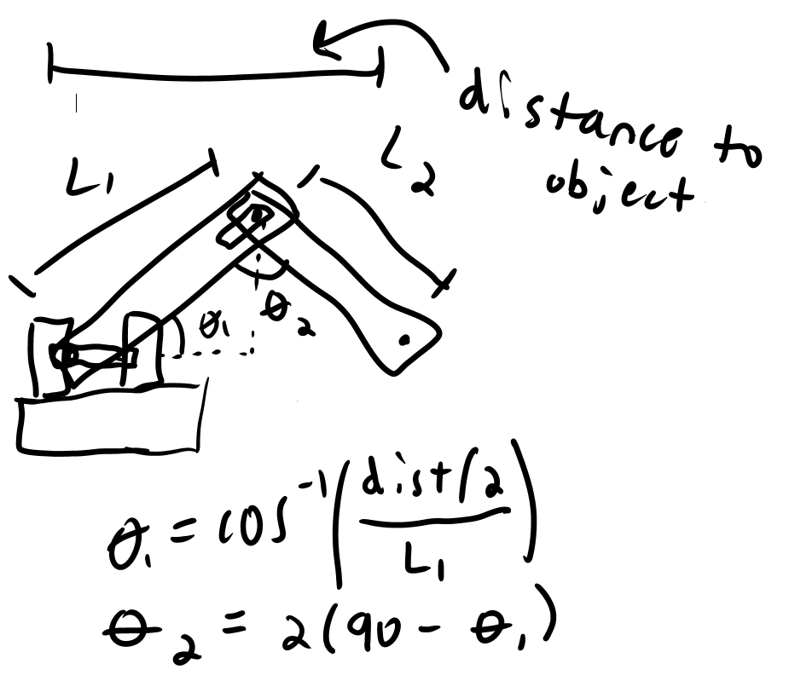
Final Proposed Design (Calculations)
Angle of base rotation
Angle of arms rotation

Slide 10
Final Proposed Design (Actuation & Sensing)
Logitech Camera
Used to find the shapes and calculate the angles necessary for the pick
Radient Servo Motors
Used to rotate the base and two arms
Integrated control circuit for accurate positioning
Electromagnet
Used to grab the metal shapes
Arduino Mega
Middleman between the camera/computer code and the servo angles

Slide 11
Budget
Sybsystem | Block Name | Description | Cost (each) | Quantity | Cost Total | Developer Name
Software | Arduino Pick Code | Arduino Code for robot to pick a shape | Free | 1 |  | Kurtis Rickelmann
 | PC C# Pick Code | C# Code for robot to pick a shape | Free | 1 |  | Kurtis Rickelmann
 | Arduino Pick n Place Code | Arduino Code for robot to pick and place a shape | Free | 1 |  | Kurtis Rickelmann
 | PC C# Pick n Place Code | C# Code for robot to pick and place a shape | Free | 1 |  | Kurtis Rickelmann
Hardware | Robot Structure | Fiberglass and Wood for structure of the robot | $20 | 1 | $20 | Kurtis Rickelmann
 | Servo Motor | Servo Motor for the rotation of the robot base and shoulder | $30 | 2 | $60 | Radient
 | Servo Motor | Servo Motor for the rotation of the elbow | $25 | 1 | $25 | Radient
 | Electromagnet | Electromagnet to pick up the metal shapes | $15 | 1 | $15 | N/A
 | Arduino Mega | Arduino Dev board for controlling robot arm | $10 | 1 | $10 | Arduino
 | 5V Power Supply | Power supply for the servo motors | $8 | 1 | $8 | N/A
 | Lazy Susan Turntable | Turntable for the base of the robot to have easy rotation | $6 | 1 | $6 | N/A
 | USB Camera | Camera to capture picture of where the shapes are | $20 | 1 | $20 | Logitech
 |  |  |  | Total | $164

Slide 12
Budget (cont.)
My original budget cap: $100
Total Money Spent: $164
Reasons for going over my budget
Servos were bought in stores vs online (servos alone were $85)
Turntable may not have been necessary
Could have used scrap wood for free

Slide 13
Prototype Results
Always problems with prototype testing
I introduced different offsets in my code for better accuracy
After much debugging and testing, I was able to fine-tune the code
Positive results will eventually come from the prototype if time and effort are put in

Slide 14
Lessons Learned
Take more time in the design and planning stages than the construction and programming stages
Many problems could have been prevented
Items would have been ordered on time
Overall would have caused less stress
Order quality parts, not the cheapest ones I can find
Servo Problems
First electromagnet was very weak

Slide 15
Lessons Learned (cont.)
Order extra parts in case of part failure
Servo Breaking
Design with some wiggle room
Barely reaches the corners
Expect things to go wrong
They always do!

Slide 16
Recommendations for Myself
Start working on future projects as early as possible
And continue to work on them throughout their development time
Don’t trust shipping times, order early
I had a couple close calls with parts coming on time
Balance work time and school time better
Didn’t manage my time away from work well enough

Slide 17
Recommendations for the Project Going Forward
More status checkpoints throughout the semester
Use some Computer Science homework for the robot arm
Instead of so much lane following homework
Keep the project simple yet complex
Yellow detection seemed unnecessary

Slide 18
Conclusions
Fun, challenging problem
Time management is key
Overall it was a success as I learned an incredible amount from this
Perhaps there should be more status checkpoints
Some CS homework should be directly related to the robot arm
Low college student budget can be hard to work with

